Slide 1
FinHeartBel
Marko, Nathan & Mo

Slide 2
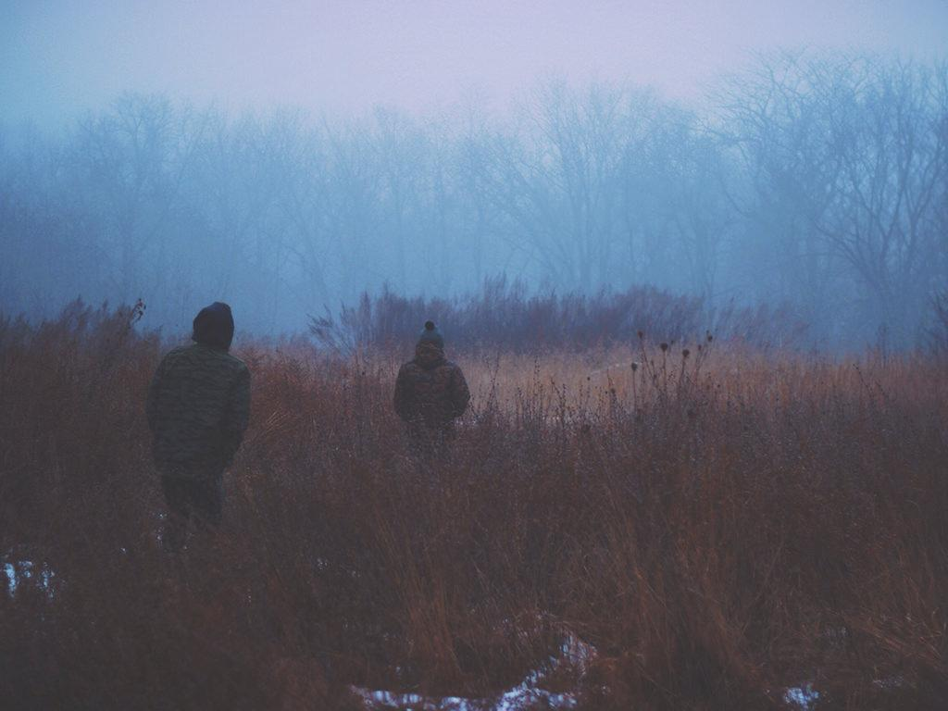
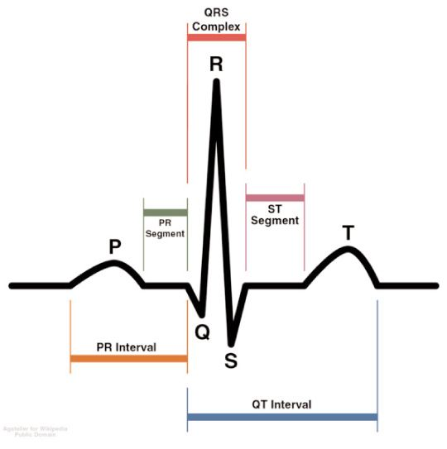
QRS complex
EDIT IN GOOGLE SLIDES
Click on the button under the presentation preview that says "Use as Google Slides Theme".
You will get a copy of this document on your Google Drive and will be able to edit, add or delete slides.
You have to be signed in to your Google account.

Slide 3
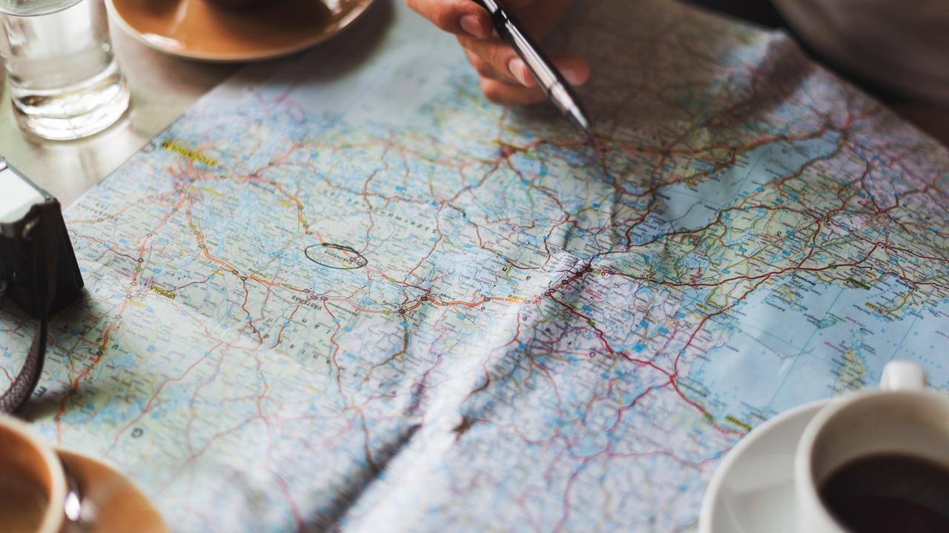
Shocking Facts all around the world
1 out of 18 has Cardiac Arrhythmia worldwide.
Cardiovascular diseases are the leading cause of death in the EU.
(2013 = 37,5%)
Heart disease is the number 1 death cause in Russia.
Approximately 500.000 Americans die every year from a heart disease, Cardiac Arrhythmia causes the majority of that.
18% of all deaths in South Africa are cause by Cardiovascular diseases.

Slide 4
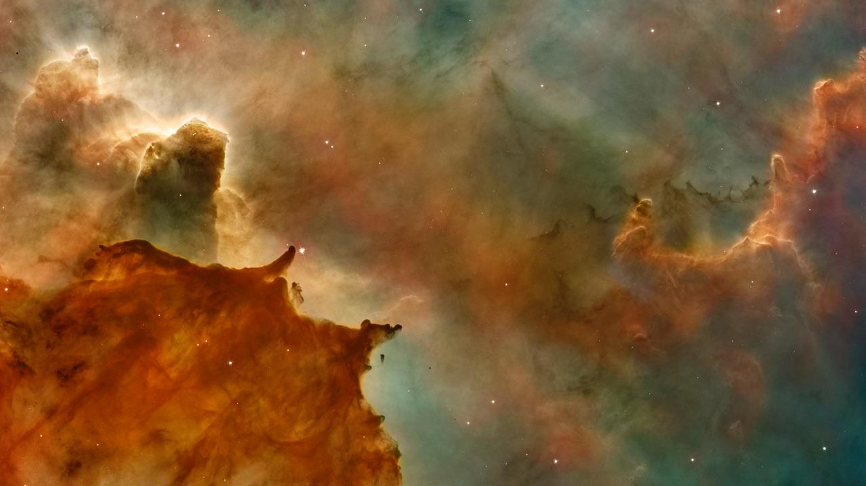
The Idea
Inform people in advance and offer them a simple solution. Keeping track of their health with FinHeartBel.

Slide 5
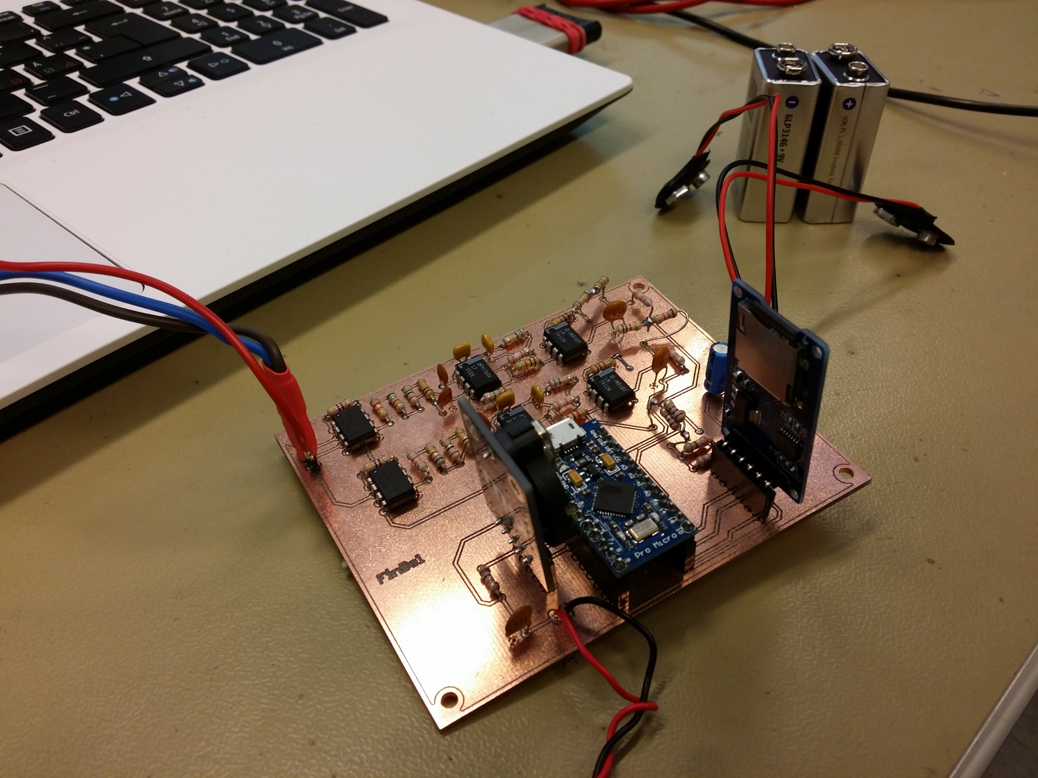
Hardware
Amplifier
Filter
Raise of voltage level
RC filter
A/D conversion
SD card

Slide 6
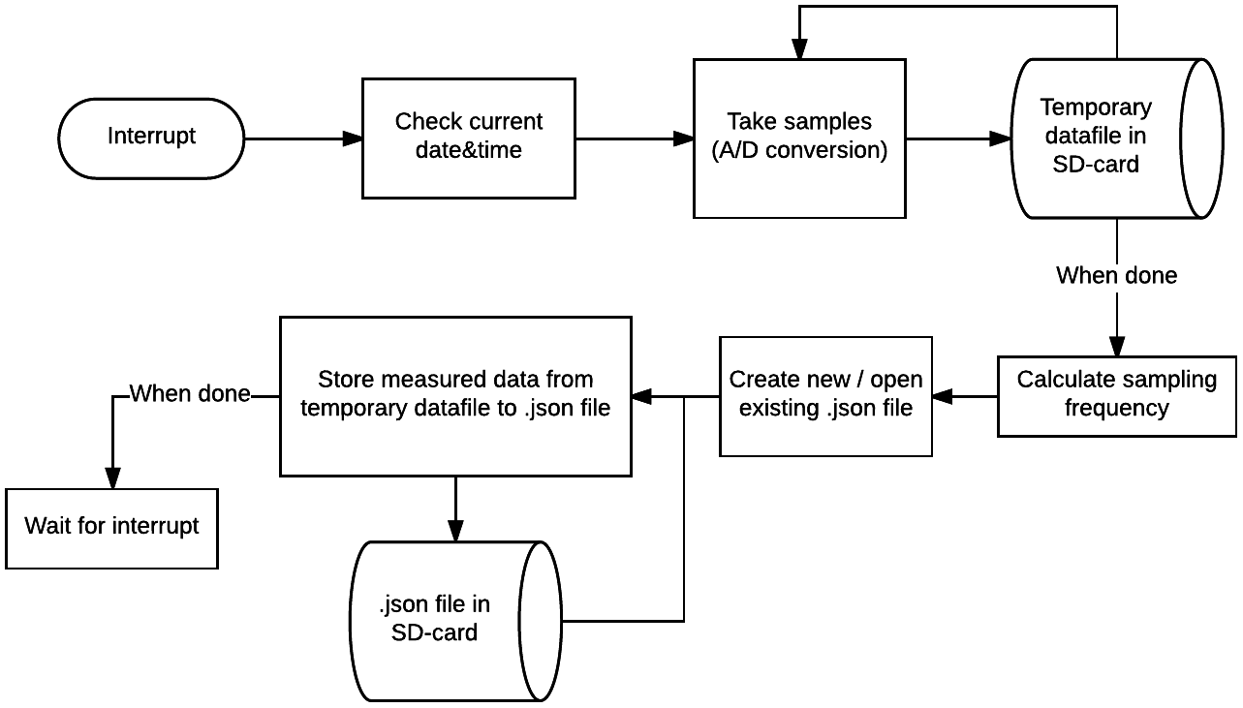

Slide 7

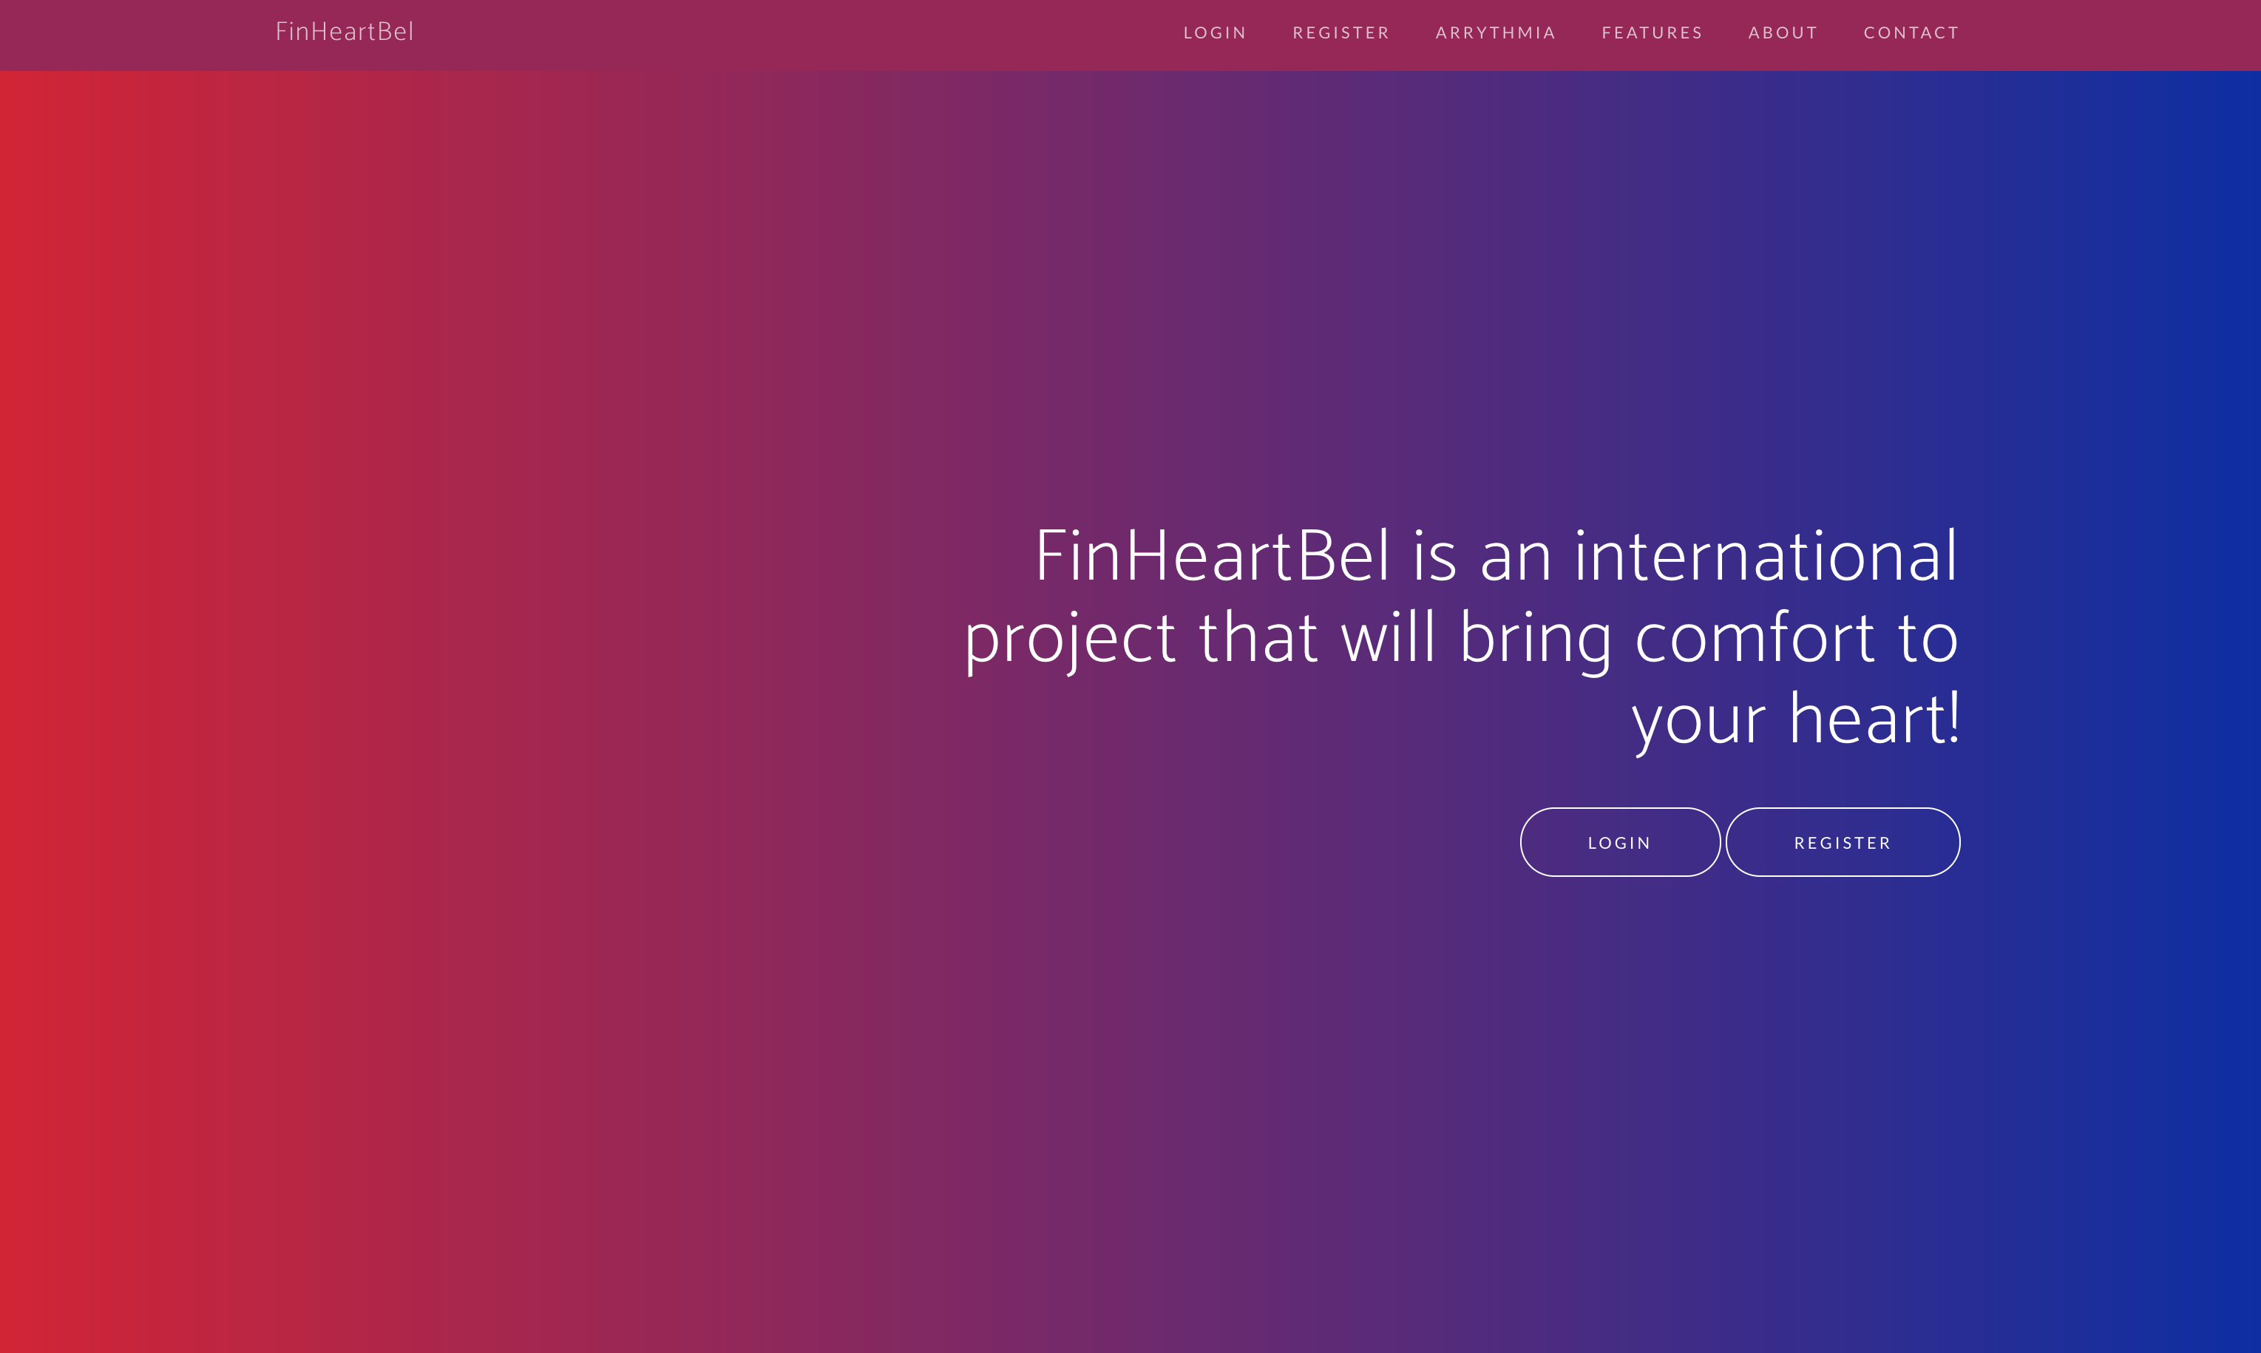
FinHeartBel
Place your screenshot here
Demonstration

Slide 8
OUR PROCESS IS EASY
Measurements with device
Analyze with our algorithm
Show metrics to user

Slide 9
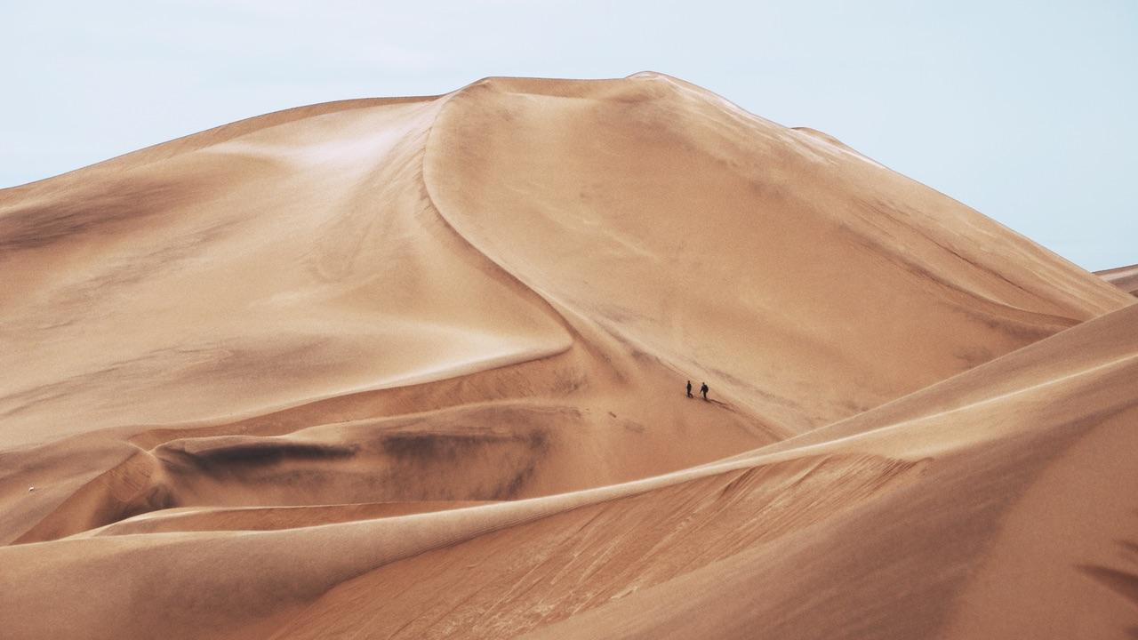
AND TABLES TO COMPARE DATA
 | A | B | C
Yellow | 10 | 20 | 7
Blue | 30 | 15 | 10
Orange | 5 | 24 | 16

Slide 10
OUR PROCESS IS EASY
Measurements with device
Analyze with our algorithm
Diagnose online

Slide 11
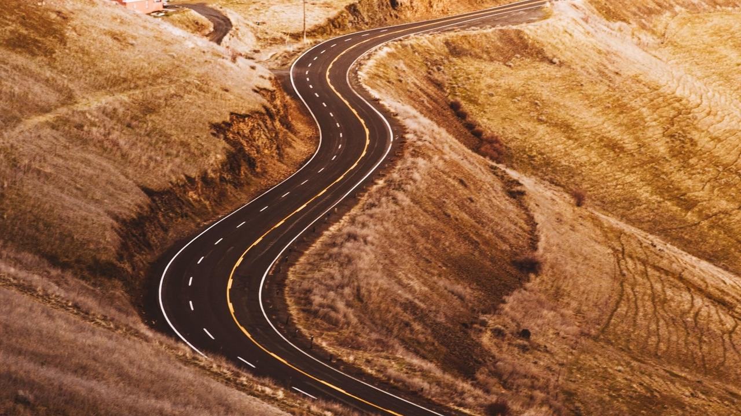
LET’S REVIEW SOME CONCEPTS
Yellow
Is the color of gold, butter and ripe lemons. In the spectrum of visible light, yellow is found between green and orange.
Blue
Is the colour of the clear sky and the deep sea. It is located between violet and green on the optical spectrum.
Red
Is the color of blood, and because of this it has historically been associated with sacrifice, danger and courage.
Yellow
Is the color of gold, butter and ripe lemons. In the spectrum of visible light, yellow is found between green and orange.
Blue
Is the colour of the clear sky and the deep sea. It is located between violet and green on the optical spectrum.
Red
Is the color of blood, and because of this it has historically been associated with sacrifice, danger and courage.

Slide 12
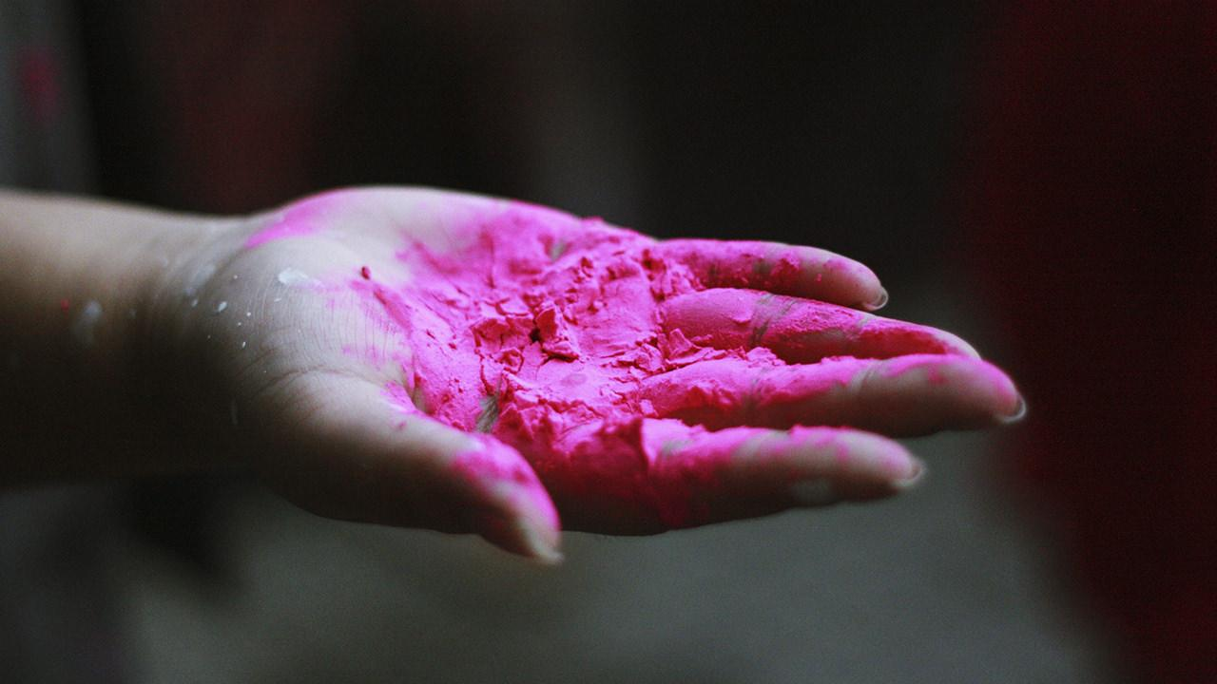
THANKS!
Any questions?
You can contact us:
nathan.aertgeerts@student.ap.be
mo.bouzim@student.ap.be
t5ylma01@students.oamk.fi

Slide 13
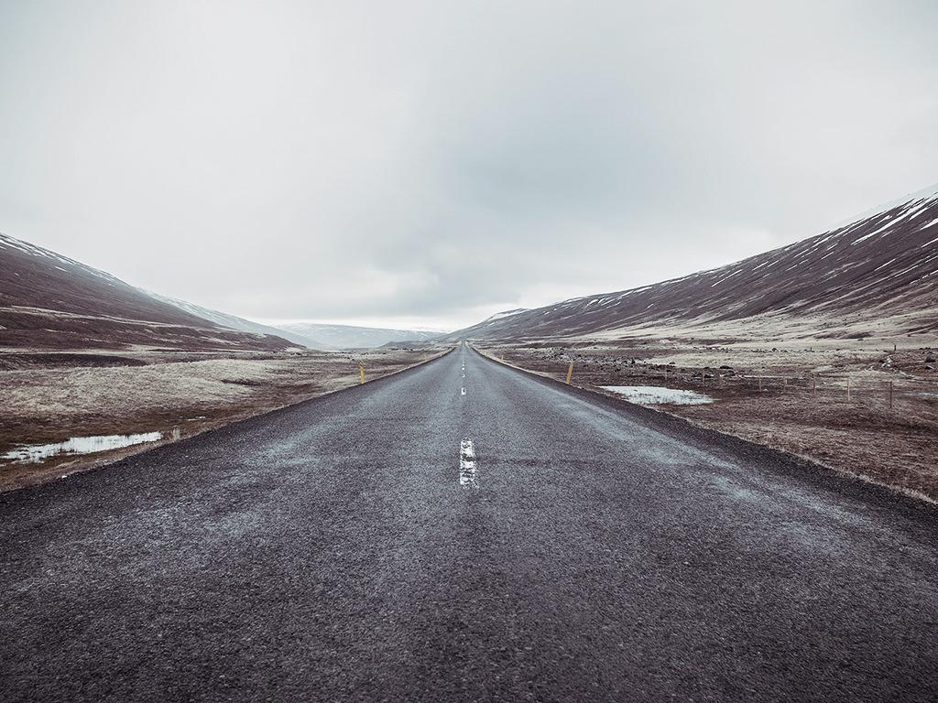
CREDITS
Special thanks to all the people who helped making this possible:
Tom & Luc Peeters
Pekka Alaluukas & Jaakko Kaski
Marko & Veli-Pekka, Nathan & Mo

